Slide 1
Introduction to Software Testing
Presentation by:
Magdalena Kilianska
Roman Jodlowski
Oliwia Kupinska

Slide 2
What is Software Testing

Slide 4
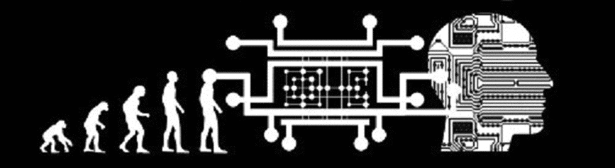

History of Software Testing
The Beginning
In the early days of software programming, testing and debugging were considered the same.
Testing got its own identity in 1957 and was viewed as a separate activity from debugging.
The Exploding Era
During the late 70s, testing focused on met specified requirements and finding errors.
In the 80s, testing became a quality measure defined as a managed process.
Development and testing were treated as separate activities.
Notes:
• Debugging was considered a software testing method at the beginning of software testing. In 1957, Charles L. Baker from RAND Corporation distinguished program testing from debugging in his review of the book Digital Computer Programming. Then, developers start testing their software in real-world scenarios; this boosted software quality assurance testing, an essential part of SDLC, i.e., the Software Development Life Cycle.
• In 1970, Winston Royce described a waterfall model; a year later, Richard Lipton proposed the concept of mutation, which is a type of software testing that includes certain source code statements that are changed/mutated to check if the test cases can find errors in the source code. In 1978, Functional testing was introduced by William Howden. The first version of the Standard for Software Test Documentation was published in 1983. From this time, the testers focus on checking the quality of the software. They scan the software until there are approximately no errors in the code. Testing had reached a qualitatively new level, which led to the further development of methodologies and powerful tools for managing the testing process.

Slide 5
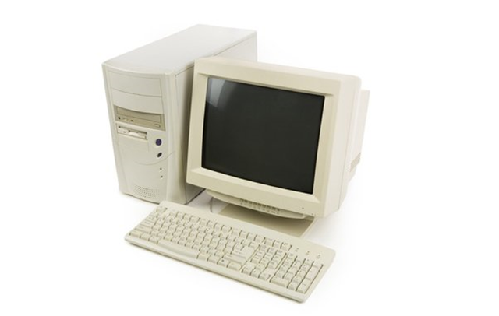
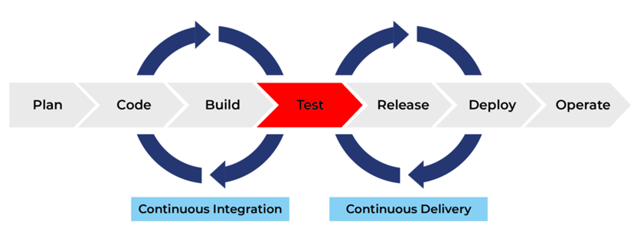
History of Software Testing
90’s
By the mid 90s, testing had its own life cycle within the software development process.
Introduction of various testing methodologies.
The Millennium
Testing became a crucial part of the software development life cycle.
Automation elevated testing.
The millennium is needed to scale up the testing.
Notes:
• The late 90s saw the introduction of various testing methodologies, including exploratory testing, which allowed for more creative and unstructured testing methods. With the growth of software development, a more comprehensive approach was needed; the consequence was that the creation of Agile testing incremental and iterative approach met this need and led to the automation of repetitive tests. This day's testing was done manually using detailed test cases and plans.
• The turn of the millennium brought new approaches to software testing that transformed the process, and testing became a crucial part of the software development life cycle at every stage, with increased emphasis on quality assurance and control. Automation has elevated testing to new heights with the availability of numerous automated testing frameworks, enabling testers to work with improved efficiency. This period also saw the need for scaling up testing, facilitated by crowdsourcing and cloud testing; these solutions allow for faster and cost-effective testing of products.

Slide 6
Testing Methodologies

Slide 7
Testing Methodologies

Slide 8
Conclusions

Slide 9
Questions ???

